Slide 1

Week 11 Sunday (PD Day) Monday 01st June – Thursday 4th June
Online Learning

Slide 2
Introduction – ‘King Shahryar and his brother’
Lesson 1 – Monday 01st June
https://www.youtube.com/watch?v=lwM2pfh2Ow8
Video link to the animated story ^

Slide 3


Tasks
Task one: Read the following slide (no.4) to understand the context behind the story
Task two: Read the story ‘King Schahriar and his brother (From The Arabian Nights)’, completing the tasks on slides 5 and 6 as you go along.
Task three: Extension-Summarise the story on slide 7

Slide 4
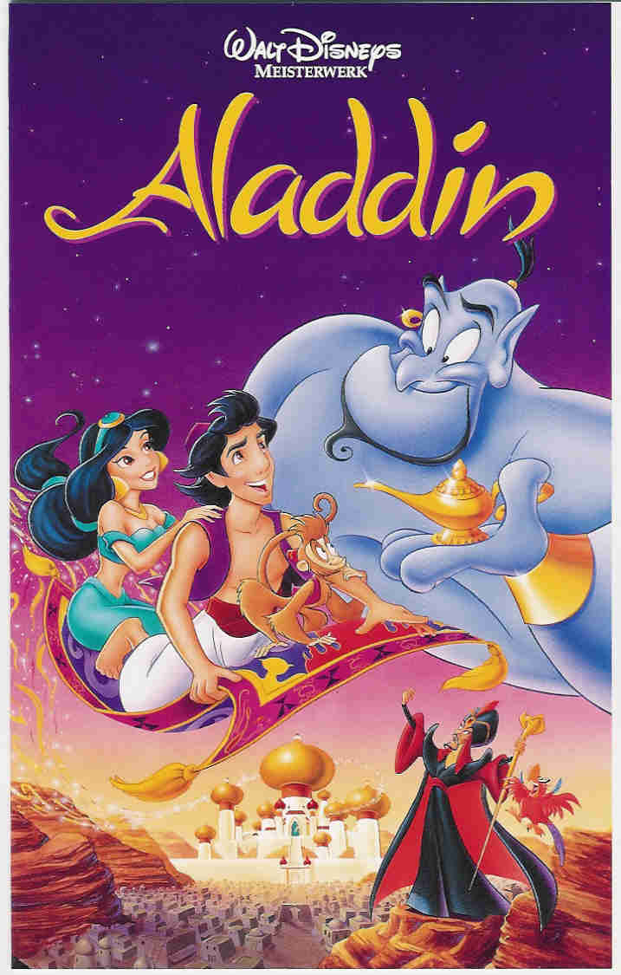
Context
They come from a long ‘oral tradition’ of folktales passed down through/over time.
King Schahriar is the first story of the collection known as ‘Arabian nights’ or ‘One thousand and one nights’ a collection of Middle Eastern and South Asian stories and folk tales. These were compiled, in Arabic, during the Islamic Golden Age or the Medieval age (around 1066 – 1500).
The stories contained have no known author and were written by a collection of
medieval scholars – you may even recognise some of them from famous Disney films
(though they are NOT child friendly and much more gory in reality)
The Arabian Nights was originally written in Arabic over a thousand years ago. King
Schahriar and his brother is the initial frame story that sets the stage for the rest.
The stories in The Arabian Nights deal with many questions about
human life and experience. They address universal concerns such as
love, death, happiness and fate in a manner that transcends cultural boundaries. They also cover spiritual matters, exploring questions about how to live in a world that contains both good and evil, with these opposites represented by various characters, such as King Schahriar and his Brother.
EXTENSION: List 4 things that you have discovered

Slide 5
Reading Tasks
Make sure you open up the story ‘King Shahryar and his brother’ saved under ‘Files’ on Teams (Week 11). You must read the entire story and complete the following tasks (as you go along or at the end).
Read lines 1-4 and list at least two things you discover about the king:
He was part of the Sassiende dynasty
2. Read lines 9-15 and answer: 1) What happened between Sultan Schahriar and his wife? 2) How did this change his perception of women?
The Sultans wife was found cheating on him therefore she was executed, after that he declared all women to be as wicked as her
3. Using lines 16-18 answer: 1) What is a grand-vizir? (You can research) 2) What was his role? 3) How did he feel about this?
A grand-vizir is essentially the head of the government, he was reluctant with this task

Slide 6
Reading Tasks
Make sure you open up the story ‘King Shahryar and his brother’ saved under ‘Files’ on Teams (Week 11). You must read the entire story and complete the following tasks (as you go along or at the end).
4. Using lines 23-27 answer: 1) What are the names of the grand-vizir’s two daughters 2) What is his opinion of his eldest daughter?
Scheherazade, Dinarzade. His opinion on his elder daughter is that she is smart and clever
5. Read up to line 50 and answer: 1) What does his daughter ask for? 2) What are the consequences for the grand-vizir?
His daughter asks to stop the Sultans mal-practice, the Grand-vizir might die.
6. Read until the end and answer: 1) Why do you think Scheherazade asked her sister to complete this specific task? 2) What do you believe happened after this?
Because she is busy dealing with the Sultan, I think that Dinarzade will fail because she is younger and stubborn

Slide 7
Extension - Summarise, in 100 words or less, what the story is about.

Slide 8
‘King Shahryar and his brother’ Continued
Lesson 2 – Tuesday 2nd June

Slide 9
TASKS:
Complete the tasks on slides 10-13
Read slides 14 and 15 (you do not need to answer the exam question today)
Extension: Plenary task on slide 15
Remember this unit of work is organised to prepare you for your transition into KS4. Therefore, you are likely to see example exam questions and possibly new terminology. Ask questions and challenge yourselves during the next few and final weeks.

Slide 10
Today I am learning to: explore the importance of language and its effects.
Starter:
Consider the first paragraph of the extract. How does the writer create a sense of wonder, magnificence and mystery in this opening? Annotate the extract with your thoughts and opinions.
In the chronicles of the ancient dynasty of the Sassanidae, who reigned for about four hundred years, from Persia to the borders of China, beyond the great river Ganges itself, we read the praises of one of the kings of this race, who was said to be the best monarch of his time. His subjects loved him, and his neighbors [sic] feared him, and when he died he left his kingdom in a more prosperous and powerful condition than any king had done before him.
Challenge: use specific Language/terminology in your annotations.

Slide 11
The opening paragraph describes a strong and diligent king and as such it builds up the reader’s expectations. The subject of the paragraph, the King, is mentioned late which builds up a majestic picture of something ancient, mystical, mysterious, and magnificent.
Superlative = a word/phrase that is used to express the highest or a very high degree of a quality (e.g. bravest, most fiercely).
Task: Can you find examples of superlatives in the first 5 paragraphs of your extract?
How does the use of superlatives add to the feeling of wonderment, power, and sense that this is ‘old’? How does it impact our opinion of King Schahriar?
Notes:
There is an extensive use of superlatives: “the best monarch”, “the greatest horror” and “excelled that of any girl.” This highlights the background of the story and the person being spoken about as someone with extreme power. It is made to seem like an exotic world with a powerful romantic appeal that the reader is led to imagine. We know Schahriar is a wonderful King who even breaks the ancient laws to make his brother king of an area. He’s [the most] generous, considerate, thoughtful, …
Any other words to describe Schahriar at this time?

Slide 12
Tone
Bullet point your ideas and use evidence from the text
In literature, the tone of a literary work is the effect that the writer creates on the readers through choice language and writing style. The overall objective is to express an attitude or certain feelings of a writer toward a subject or an audience.
Tone is generally conveyed through the choice of words, or the viewpoint of a writer on a particular subject.
How does the tone of the story develop in the first 4 paragraphs?
Some words you MIGHT use to discuss tone…
serious, comical, spectacular, distressing, archaic, sombre, grim, amusing, droll (funny), thoughtful, impressive, solemn, mighty, sad, painful, shocking,

Slide 13

Pick a Task
Task One:
Design a story board highlighting 5 key events and summarise each moment
Task Two:
Create a bank (minimum 5) of inquisitive questions to ask the characters in the story
Task Three:
Identify the Genre, Audience, Purpose and Style of the text and use evidence to support your ideas
Task Four:
Challenge yourself to write a response to the example exam question on slide 15 OR answer: In what ways do you think Scheherazade is a good female role model? Use quotes from the text

Slide 14
Example annotations
The introduction to this extract deludes the reader into believing it is a fairytale story, as expectations are built up of this strong and diligent leader whose ‘subjects loved’ and ‘neighbors feared.’ Again, there are many superlatives describing his love for his wife.
TASK: What are they? Find some.
This perception is soon forgotten as the tone of the extract changes to the wife’s deception [to add to the mystery and intrigue, we never discover what she did]. There is bitter resentment behind the belief that ‘at bottom all women were as wicked as the sultana’.

Slide 15
EXAMPLE EXAM STYLE QUESTION
HOW DOES THE WRITER CREATE A SENSE OF WONDERMENT IN THE OPENING OF THE STORY? YOU MAY WISH TO CONSIDER:
Build up of characters
Use of language (superlatives)
Change in tone
Synonyms:
awe
admiration
fascination
surprise
astonishment
amazement

Slide 16
Plenary
Choose the correct word:
“This behaviour caused the greatest horror in the town.”
The use of a __________ depicts the severe contrast between the Father’s ruling and Schahriar’s.
Superlative - Personification - Simile
“In the chronicles of the ancient dynasty of Sassindae, who reigned for about four hundred years, from Persia to the borders of China….”
This ______ sentence gives the extract a fairytale, narrative tone.
Short Long

Slide 17
Catch up Library Lesson: Spellings and Read Theory
Lesson 3 – Thursday 4th June

Slide 18
TASKS:
TASK ONE:
Spend 15 minutes catching up from work this week (ensure your Notebook is up to date and organised)
TASK TWO:
Complete the Spelling Test on Show My Homework
TASK THREE:
Log onto Read Theory – this will be tracked

